Slide 1
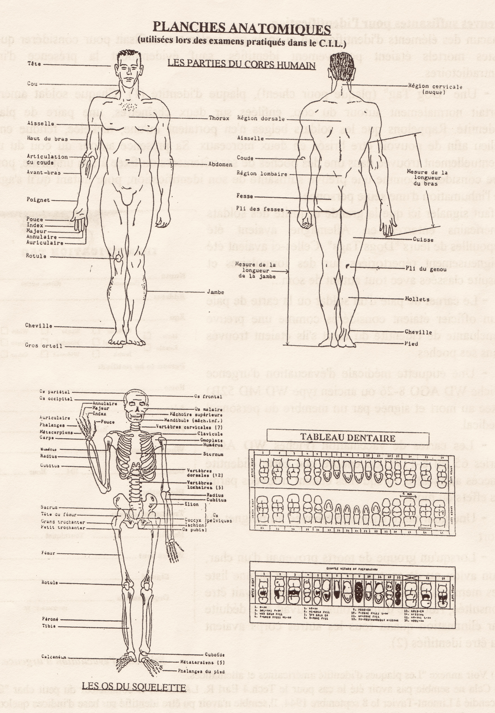
Identity Variables
Tracing Missing Persons Past and Present:
lessons from managing data of missing persons in humanitarian forensics
C. McDermott May 2026
Notes:
https://mildredtrotter.org/id-var/

Slide 2
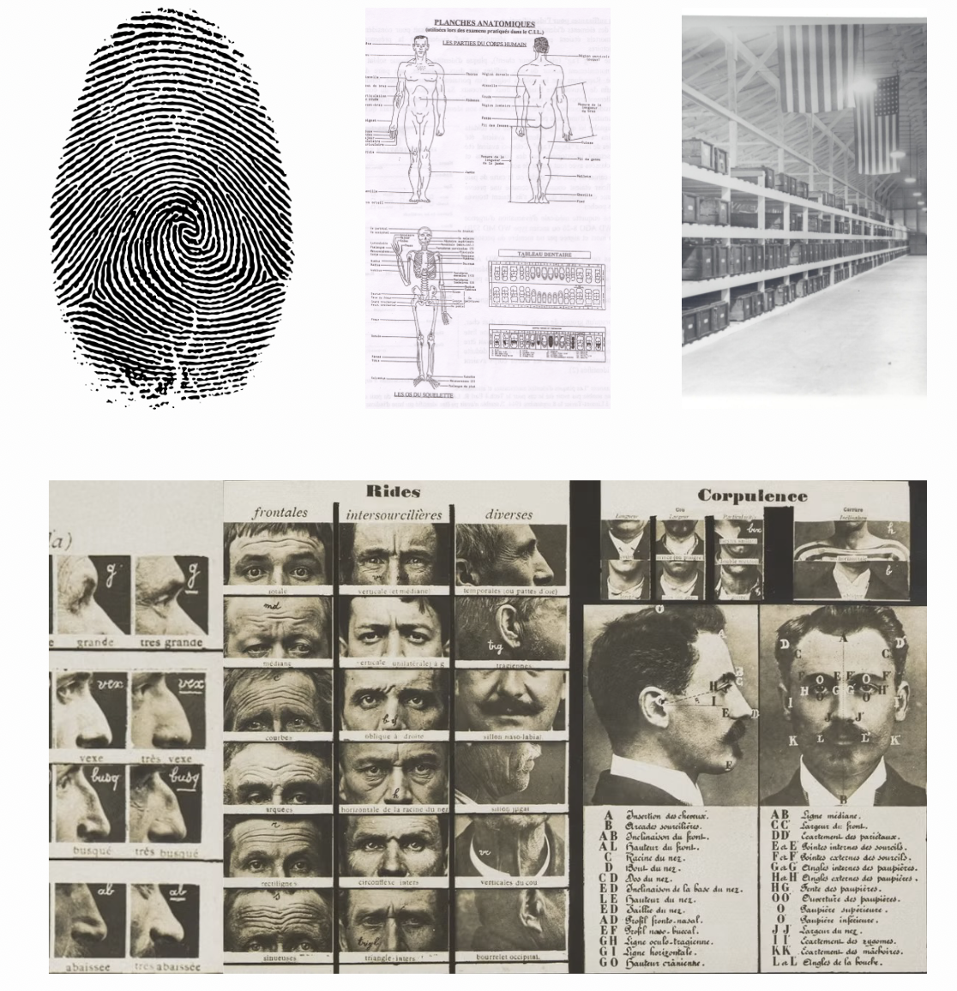
Individuals, Societies & States
Identity tracing regimes took a state supported technoscientific turn in the late 19th C
Bertillonage - 1880s
  Anthropometry
  Mugshots
Fingerprinting ~1900
  Galton
  Calcutta Anthropometric Bureau
Military and Police
  Scars, Wounds, abnormalities and standards
  Serial numbers, uniforms/clothing ,insignia, personal effects, clothing laundry marks
Notes:
In the late 19th C. Questions of race, identity, and funerary practices began a techno-scientific journey that affects the humanitarian management of the dead today. Scientific explorations begun on these themes applying to issues of the medical, legal worlds, and concepts of identity and belonging. Our science of anthropology contributed tightly to the premises and then the scientific failure of some programs and frameworks, alongside the growth of other more specialized and blended science frameworks.
Racial Typologies turned to grouping efforts, clear lines or features, found only individuals with blurred boundaries, biology found genetics and non-uniqueness of “man” or “unique in the kingdoms of Life”. Meanwhile the political and social economies of death and remembrance grew and developed in the west, the colonies, and in contact with the greater world. Embalming, ritual, undertakers, gravediggers, waves of death, resentment and remembrance.

Slide 3
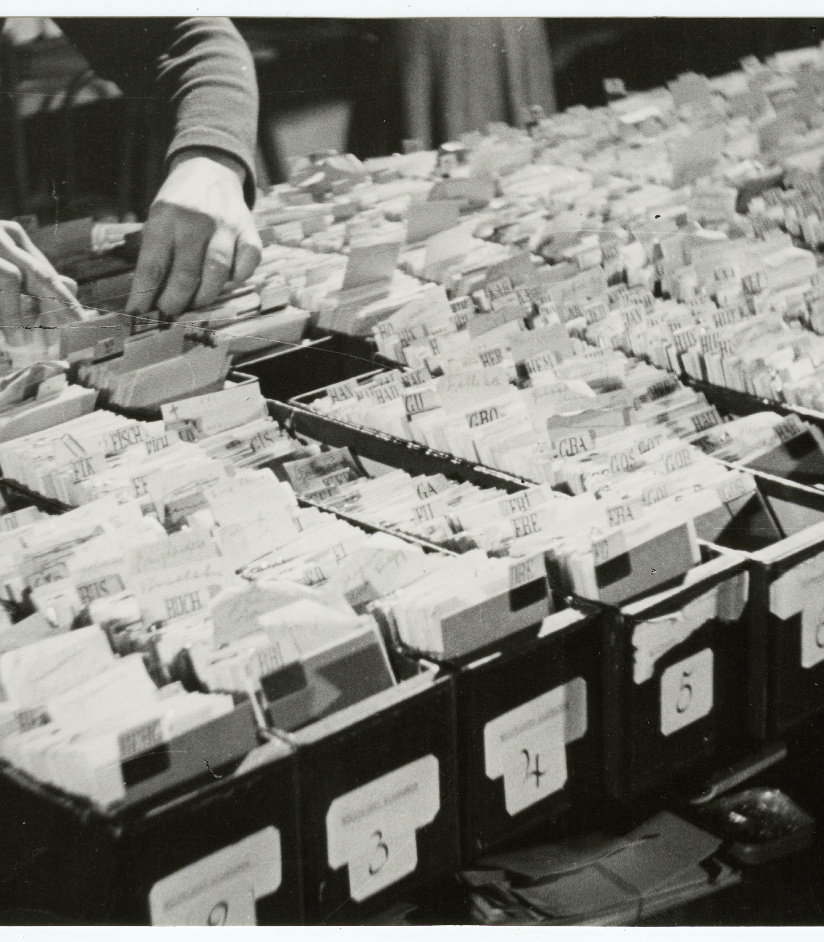

Tracing in WWII
Names, Numbers, and Traces
The ICRC Central Tracing Agency
  Prisoners, displaced persons, refugees, tracing requests
FBI fingerprint cards for ~16,000,000
  Servicemembers in uniform for the United States
  Dog tags - Name, Rank, Serial Number, Blood Type
  Regimes of tracing, IBM cards, Tattooing, Mass Movement, Mass Graves, global scale
Notes:
1929 Geneva Conventions, following the crisis of a global conflict, technological and mass mobilization for war.
We shall know them by their IBM cards.
Fingerprinting of the dead…
John Aieivoli and Harry Shapiro
Teeth of the dead

Slide 4
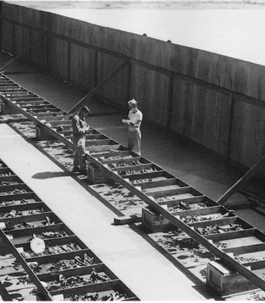
1940- 1950 Politics - Global
Individual - Identity
Katyn - Nanking
Death Camps - Dachau - Georges C. Fully, survivor, legal medicine practitioner, prison reformer
Krogman - FBI Bulletin 1939
Nation-States/Peoples-Families Searching
  Geneva Conventions
  AGRS/AGRC
  MREU
  United Nations/Red Cross/Declaration of Human Rights
Types and individuation
  Race, Sex, Age, Stature
  Blood Types, Serial Numbers, Visual Identification, Fingerprints

Slide 5
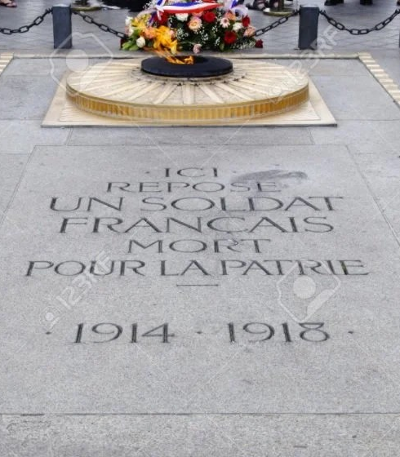
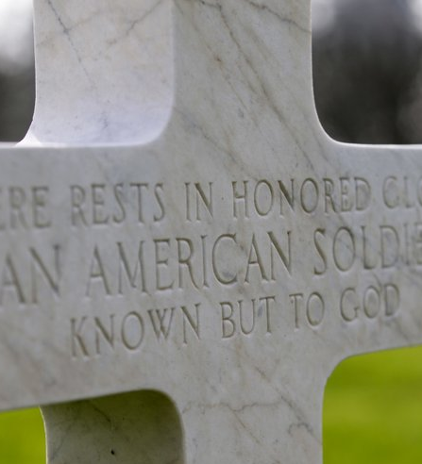
Unknown Dead
Identity Variables and Lost Data
Centralization
Standardized Scientific Processing
‘Do the best you can’
Attitudes towards death
  individuals and closure
One(s) to represent all
  Nation-States and closure
  Honored dead and Hallowed Ground
Notes:
3.5 % remains unidentified - Trotter and ‘do the best you can’ USS Oklahoma, ship names on unknowns grave stones.
How to select an unknown
Criteria for Korea and WWII unknowns for interment at Arlington in the US.
Assessed as American by material evidence, uniform, insignia, location
~80% complete
Remains sent from multiple locations for WWII and Korea, set of remains selected as the entombed unknowns, others and the records submerged under the Potomac river.
CIPs Strasbourg
CIU
CIL
Wenner-Gren
Army allowed studies - Trotter WWII and Korean War dead, McKern and Stewart - Korea data on aging Anthropometric studies - economies of scale
Research on the dead (basic science) studying the dead, studying race, personhood determined by biology

Slide 6
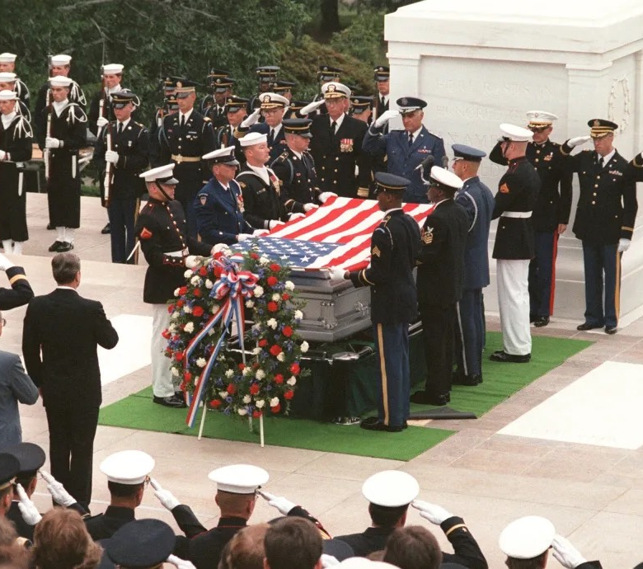

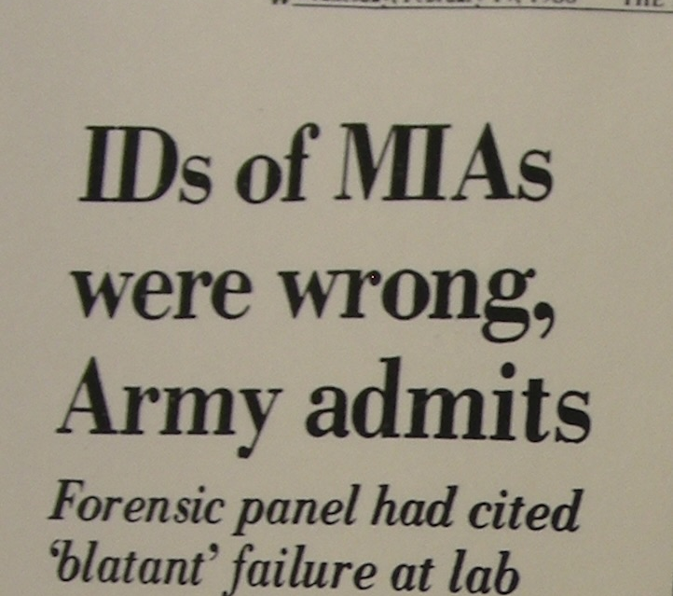
US 1980s Politics, the Missing, and Tracing
Notes:
Reagan and Casper Weinberger 1984 US politics
POW/MIA wives, mothers, families the messy end of the Vietnam War
Morphometric approximation, Army Administrated IDs based on technical manuals and military approval
You are not forgotten, truth lies, mistakes, and the hope of science
Ellis Kerley AAFS President, Lowell Levine DDS, William Maples - Florida

Slide 7
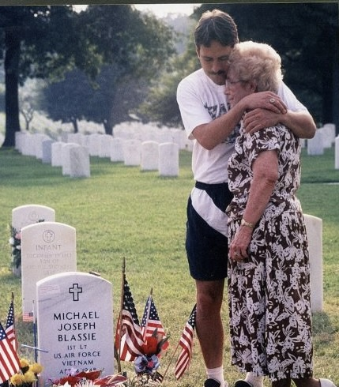
1st Lt. Michael J. Blassie
Formerly the Vietnam Unknown
1998 exhumation and identification
  Confirmed by DNA testing
  And evidence placed in the coffin
    Both biological and artifacts
Notes:
How did this unravel…
The family advocacy and veterans’ service groups possessed knowledge outside of the administrative state controlled processes
ID card, message traffic, administrative management of the dead, versus scientific and humanitarian management of the dead
The scientific community both had legacy benefit from the history within the military identification program, but also had developed prestige independently outside of the military.
Material evidence, contextual evidence
Meeting the criteria politically changing the criteria 80% to 6%
No more MIAs now DSTU
No more POWs - combatant detainees
Rambo, Chuck Norris, Thunder Road

Slide 8
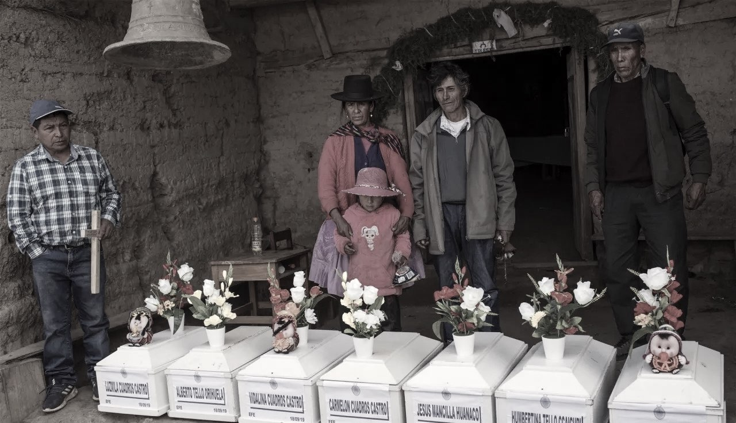
Humanitarian Forensics
“As a result of armed conflict, other situations of violence and natural disasters, people can get separated from their families, go missing or die. They may also become victims of ill-treatment and sexual violence, especially in the context of detention, displacement and migration. Medicolegal systems and forensic institutions play an essential role in addressing these issues of humanitarian concern. Humanitarian forensic action is the application of forensic science and investigative principles to humanitarian work. systems and forensic institutions play an essential role in addressing these issues of humanitarian concern. Humanitarian forensic action is the application of forensic science and investigative principles to humanitarian work” - ICRC

Slide 9
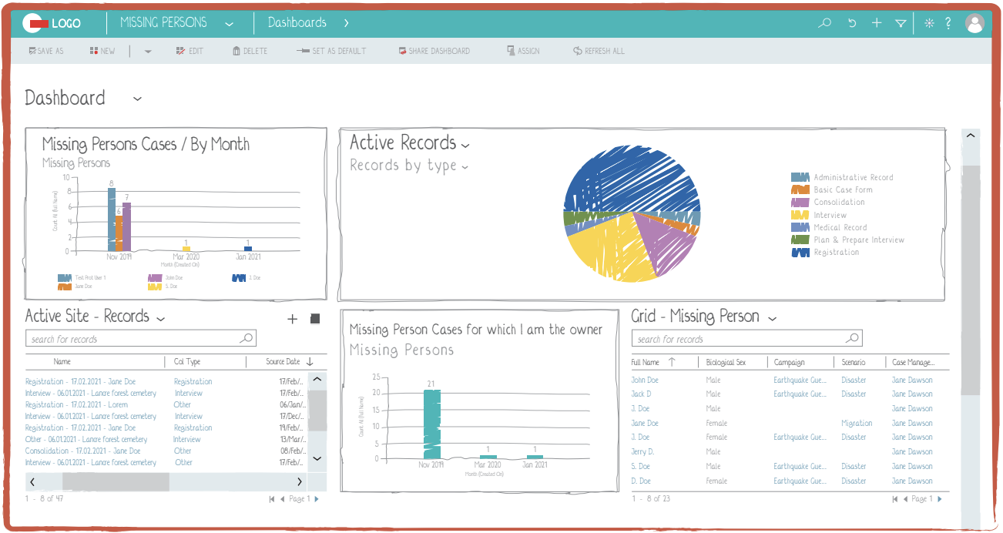

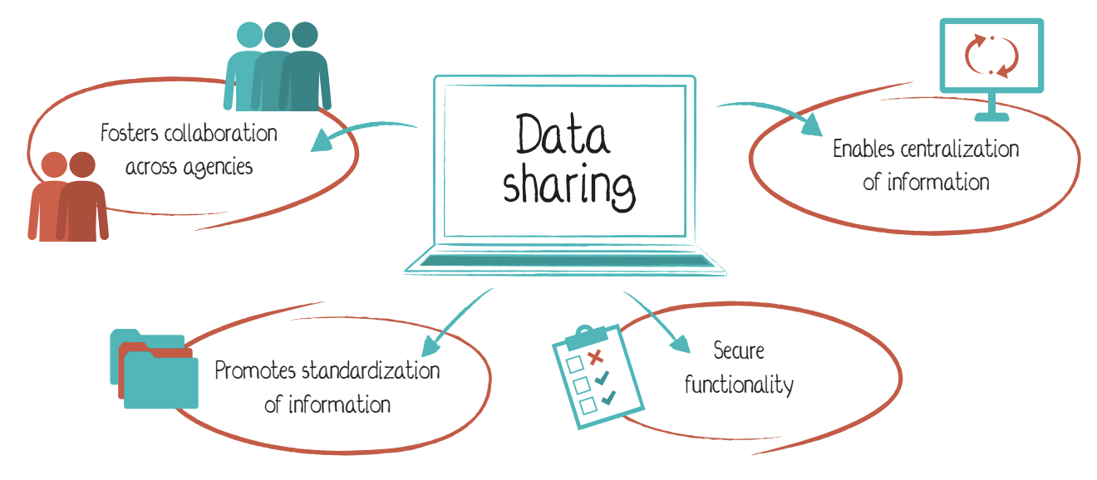
Forensic Data Management
Investigating & Tracing
Missing Persons Data
  Loss circumstances
  Medical and Dental
  Human networks
Data on Unidentified Remains
  Recovered remains
  Biological and Material evidence
Geospatial Data
  Last known location
  Possible grave sites, mass graves, clandestine graves
  Recovery context
Witness Statements and Records

Slide 10

Identity Variables
Missing Data
Managing Traces
Missing Persons Cases begin with ?????
  Cases of Missing Persons always include lots of missing data
  Recovered evidence is always a small set of the universe of clues
Acts of tracing involve multidisciplinary and expert investigation
Answers and inquiry must aim at demonstrated care for the missing person and those most missing them

Slide 11
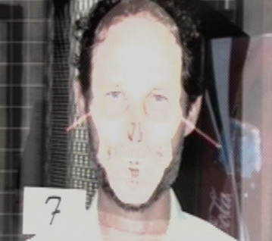
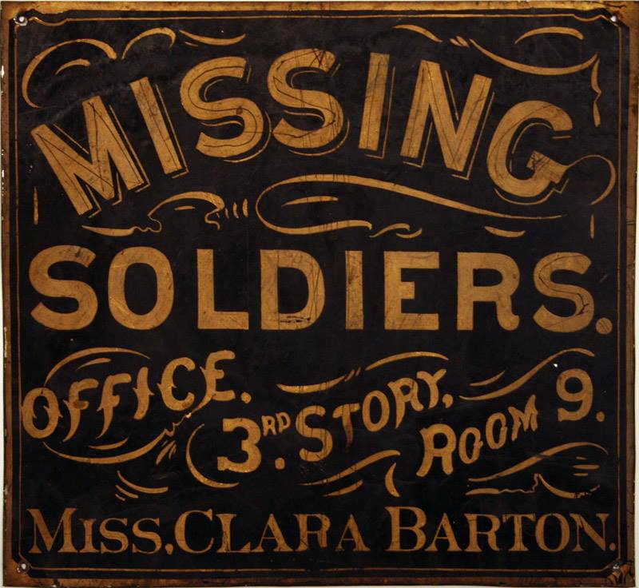
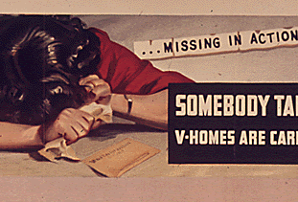
Who knows us?
To whom do we belong?
Notes:
Smiling pictures

Slide 12
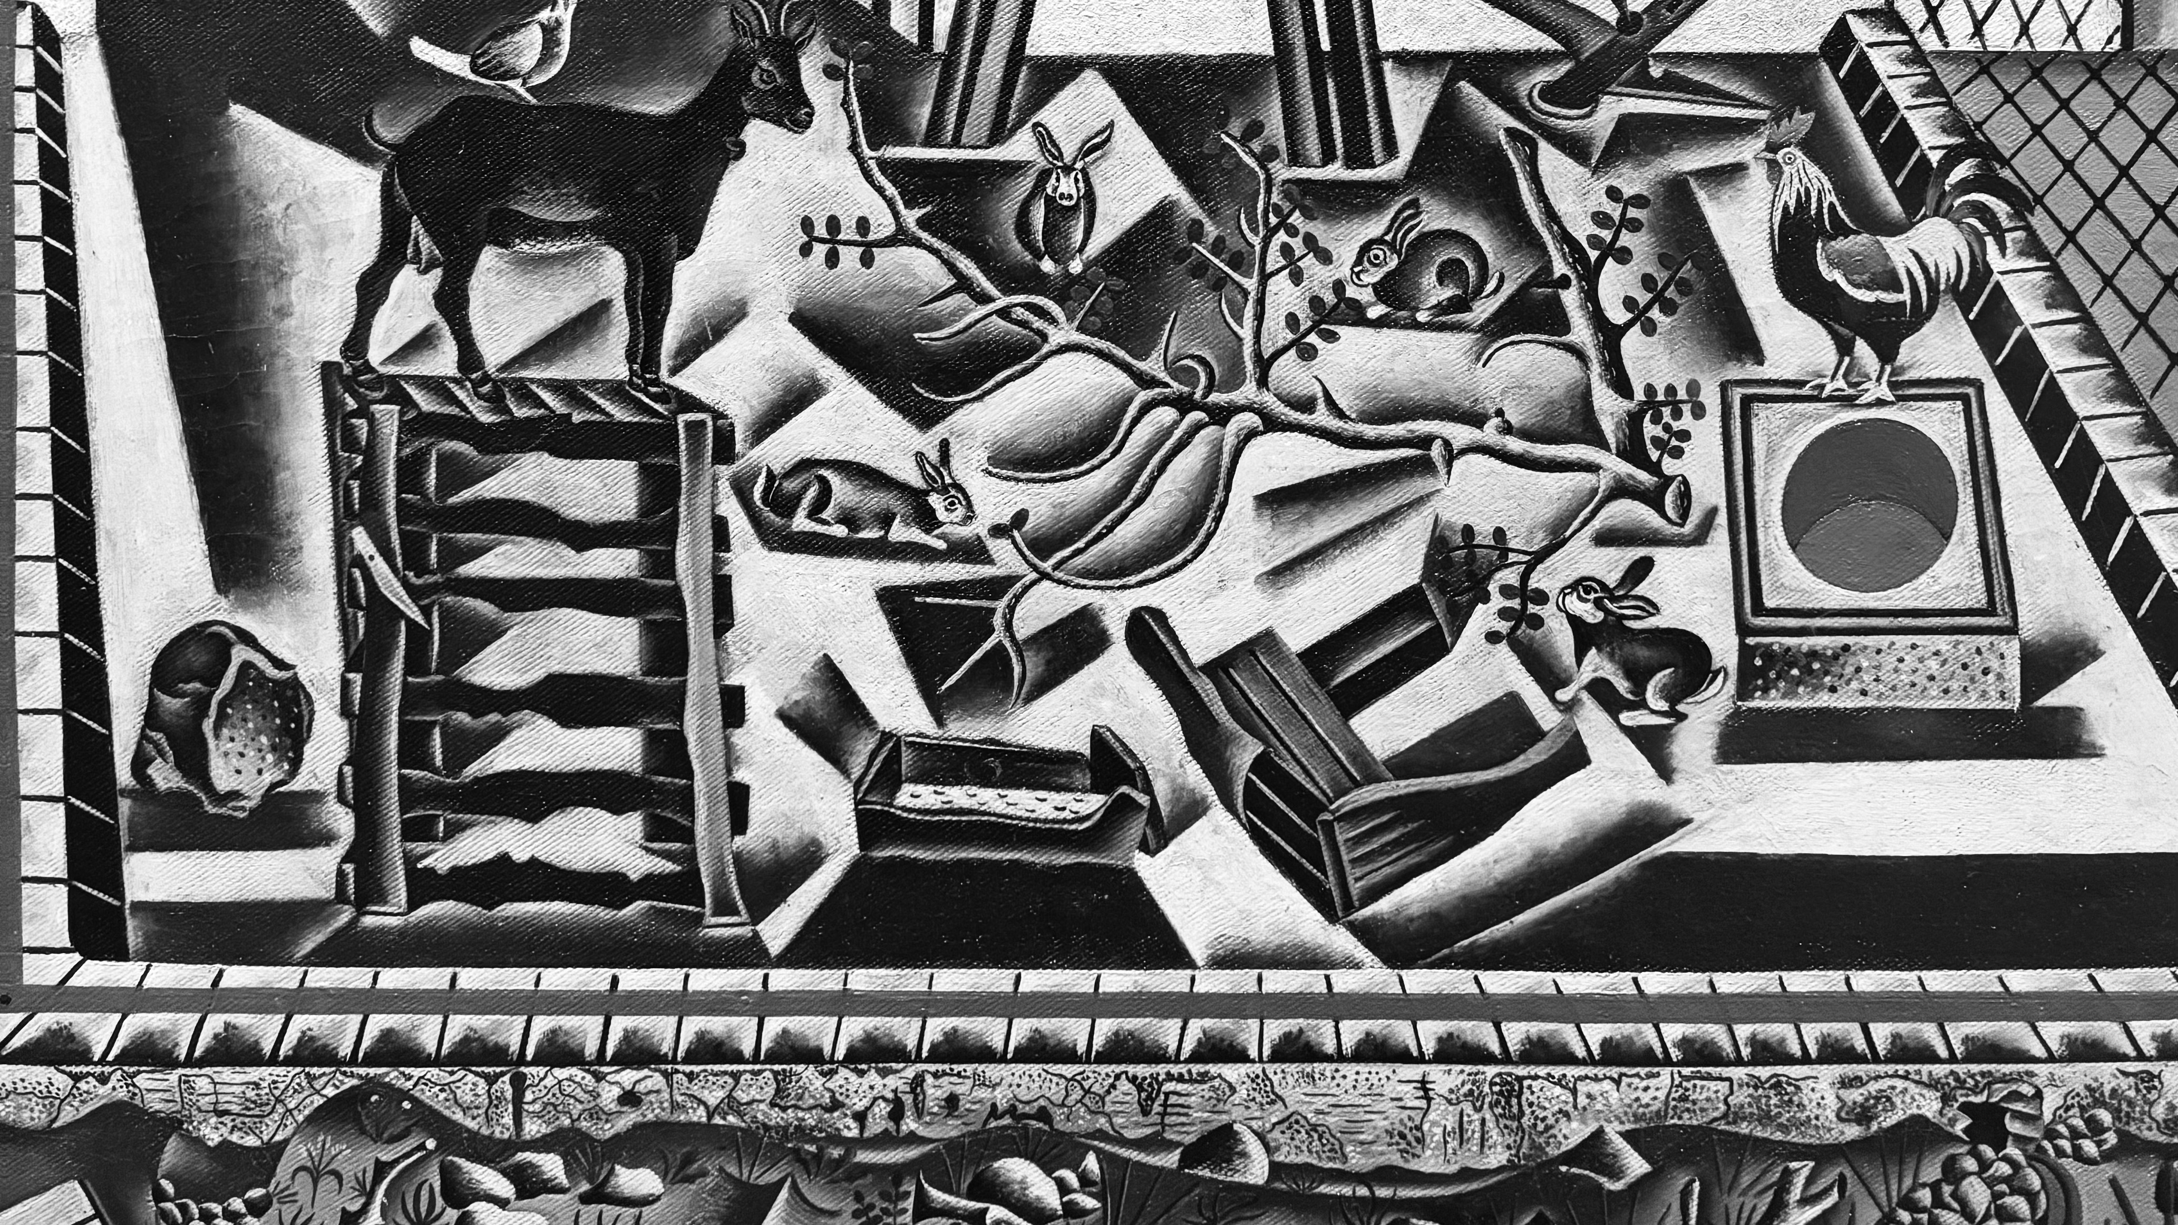
Traces
Right to Disappear
Right to be Forgotten
Duty of Sepulcher
Duty of Remembrance
    C. McDermott May 2026. AIAS - The Polictics of Traceability Workshop
Notes:
https://en.wikipedia.org/wiki/The_Farm_(Miró)

